Slide 2
Detection and Estimation Theory
Dr. Emad H. Salman
Third Year
Department of Communications Engineering
COLLEGE OF ENGINERING / UNIVERSITY OF DIYALA

Slide 3
3rd Year
Detection and Estimation Theory
Dept. of Communications Eng.
GENERAL INFORMATION
TEACHER: Lec. Dr. Emad H. Salman
COURSE DESCRIPTION: The aim of this course is to introduce the students to the basics of Statistical Signal Processing with emphasis on the application of this field to detection and estimation analysis. Such methods play a crucial role in the analysis and interpretation of data in almost every field of science. The course will present the general mathematical and statistical framework of Statistical Signal Processing with special emphasis on examples from Communications engineering and physics. The course will cover the topics of Estimation theory, Moments analysis, Filtering and Sampling theory. Problem sets and computer assignments are substantial and integral part of the course.
LITERATURE: The course will rely on the lecture notes and will not follow a specific book in detail. However, there are two books that give a general overview of the material that will be covered in the course.
Fundamentals of Statistical Signal Processing: Estimation Theory, by Steven M. Kay.
Statistical Signal Processing, by Don H. Johnson.
COURSE HOURS PER WEEK: 2 hours of lecture and 1 hour of tutorial
GRADING: The class participation, homework assignments and computer project are an integral and mandatory part of the course. However, the student must submit all homework (with grade 5%) and computer projects (with grade 5%). Quizzes with grade 30% and then final grade will be 40%. The final exam will be 60%
CLASS MOODS: To create a class filling with knowledge and pleasure for all students, please follow these activities; be punctual, do not speak with your friend/neighbor to avoid any possible disturbance, and turn your mobile off (or, at switch it to vibration mode).

Slide 4
3rd Year
Detection and Estimation Theory
Dept. of Communications Eng.
Syllabus:
Introduction of Statistical Signal Processing.
Detection Theory and Estimation Theory.
Bayesian Detector.
Hypothesis Testing.
Maximum Likelihood (ML) Detector.
Maximum a posterior Probability (MAP).
Neyman-Pearson Detector.
Maximum Likelihood (ML) Estimator.
Minimum Mean Square Estimator (MMSE).
Linear Least Square Estimator.
Kalman Filtering.
Cramer-Rao Bound.
Recursive Estimation.

Slide 5
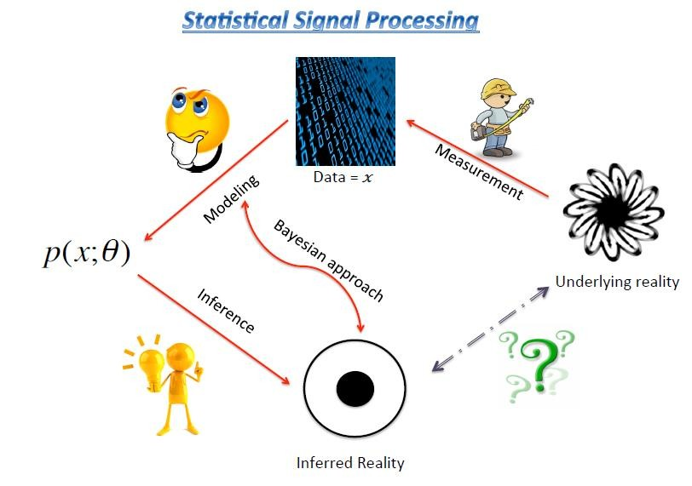
3rd Year
Detection and Estimation Theory
Dept. of Communications Eng.
1. Introduction of Statistical Signal Processing.
In general, every statistical signal processing problem has a number of essential elements, which we list below:
MEASUREMENT: One normally measured a quantity (or more), say x, which is measured N
times. Hence the vector 𝑥 = {𝑥[1], 𝑥[2], … , 𝑥[𝑁]} represents the data.
MODELING: This gives the statistical model that describes the relation between the underlying quantities, normally parameters’ vector θ, and the data. In probabilistic terms this can be written as 𝑝(𝑥; 𝜃)_{𝜃𝜖Θ}. Here Θ is the space from the parameters are drawn. Notice that besides θ we assume that we know the PDF (Probability Density Function) of the process.
Inference: gives the best value of θ best fits the data. This generally has a number of components which often are referred to as:
Detection and parameters estimation (both can be viewed as “estimation”);
Prediction (inferring the value of a signal y given an observation of a related, yet different, signal, x;
Learning which means that we learn about a relation between two stochastic signals x and y
from the data we have.

